Slide 1
Epic Scanning
9/7/2021

Slide 2
AGENDA
7:00am Introductions, Log-ins, Epic Overview
8:00am Scanning Grid Overview, Patient-Level Scanning
9:00am Encounter-Level Scanning
11:00am Order-Level Scanning
12:00pm BREAK for LUNCH
1:00pm Order-Level Scanning Continued
2:00pm Advance Directives
3:00pm Scan Error Corrections

Slide 3
Epic Overview
Patient Lookup
Chart Review Tabs
Storyboard
Media Manager
Filters
In Basket
Care Everywhere

Slide 4
Patient Lookup
Finding a patient in EPIC
Go to EPIC → Patient Care → Chart
Pin Chart
Enter patient information (Name, MRN, DOB) in the ‘Patient lookup’ screen and click ‘Find Patient’ or press Enter
Select correct patient from ‘Patient Select’ screen

Slide 5
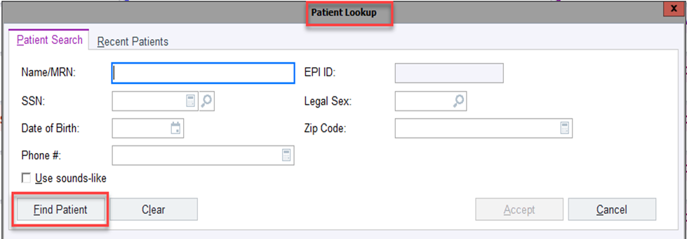
Patient Look Up
Time to Practice
Look up your first test patient via Chart

Slide 6
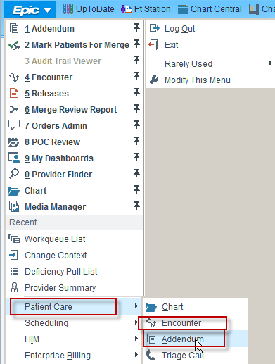
Patient Look Up
You can also look up patients via:
“Media Manager”
“Encounter” (To access an encounter that is open)
“Addendum” (To access an encounter that has been closed/signed)

Slide 7
Chart Review
Click “Chart Review” and select the appropriate “TAB”
Encounters tab
Displays all patient encounters
Lab, Imaging, Procedures, CARDIAC DX
Displays all corresponding diagnostic results and orders
Notes
Displays all electronic and scanned documentation that qualifies as a note
Ex: H&P, Consult, D/C Sum, Progress Note, Procedure Note
Media
Displays all imported & Scanned documents & diagnostic results

Slide 8
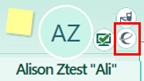
Storyboard
Displays:
Patient Demographics
Advance Care Planning Information and Alerts
Other Important Patient Highlights
Link to Care Everywhere
FYI Flags

Slide 9
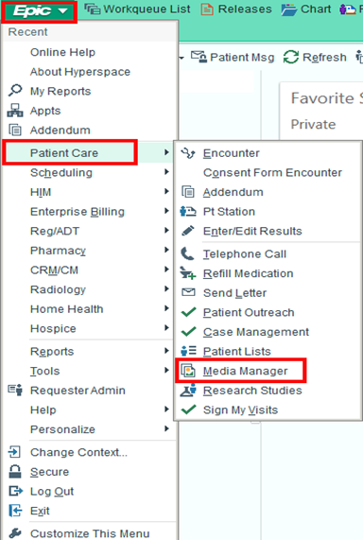
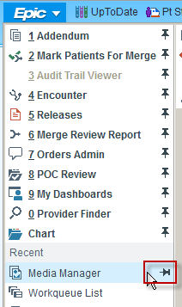
Media Manager
Media Manager houses all media including scanned/imported documents, and allows users to edit scans
Click on EPIC-> Patient Care -> Media Manager
Hint: Pin “Media Manager” to save as a favorite

Slide 10
Your Turn… Lookup Test Patient in Media Manager

Slide 11
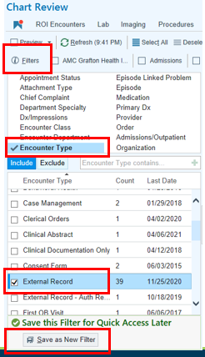
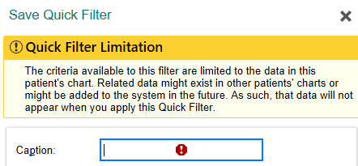
Filters
Create filters in the Encounters tab for efficiency:
Click Encounters tab
Click Filters
Click Encounter Type
Select the encounter type to create a filter for
(i.e. Advance Directives, External Record)
Click “Save as New Filter”
Enter a Caption then click Accept

Slide 12
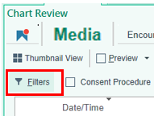
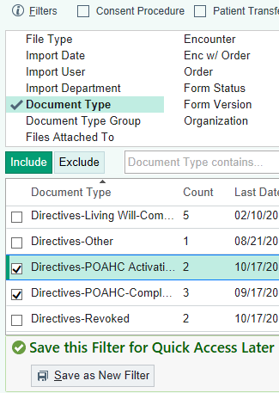
Filters cont.
Create a Document Type filter in the Media tab for efficiency:
Open Chart Review, click Media tab
Click Filters
Click Document Type(s) to create a filter for
Click “Save as New Filter”
Enter a Caption then click Accept

Slide 13
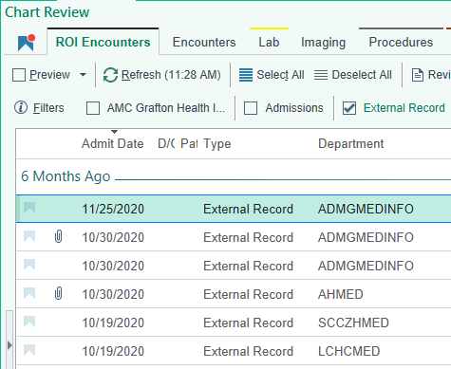
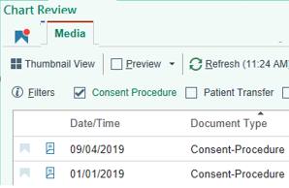
Filters cont.
After a filter is built you can click to instantly see all encounter or document types associated:

Slide 14
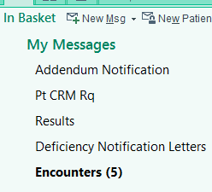
In Basket
Your Epic In Basket offers several features. Folders on the left will appear only if there are items within that folder.
Encounters
Encounters that you create (except for External Record Encounters) need to be signed and closed:
Click on the Encounters folder, click on a row, then click Sign Encounter

Slide 15
Care Everywhere
Care Everywhere (CE) exchanges health information between organizations
All documentation from an organization that uses Epic is in CE and should not be scanned, except for health maintenance documentation (ex. mammograms, colonoscopies, etc)
To view documents in CE:
Click on the CE symbol on the Storyboard
Click Documents

Slide 16
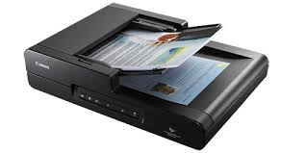
Now let’s learn about scanning!

Slide 17
Scanning into EPIC
​​High-Quality Scanning​ is extremely important to maintain the accuracy and integrity of our patients’ medical record documentation in the shared electronic health record. It is necessary to ensure:
Patient Safety​
Quality Service​
Accurate Treatment​
Clinician Decision Support​
Health Insurance Portability and Accountability Act (HIPAA)
Compliance​
Accurate Release of Information
To ensure correct information is released when using release templates
Prevent Protected Health Information from inappropriate release, which can lead to a HIPAA violation.
​

Slide 18
Scanning Timeframes
Diagnostics (radiology exams, labs, cardiac tests, eye exams, etc.) within 5 years will be scanned to order-level.
Exceptions: scan ALL Colonoscopies, Pathology, and Sleep Studies from ANY date to the order-level.
All non-diagnostic documents within the past 5 years will be scanned to encounter-level
Exception: scan all Implant records and Obstetric (OB) Histories from ANY date to the encounter-level.
Anything that does not meet the above timeframes should not be scanned, unless the clinician specifically requests an exception.

Slide 19
Scanning Grid
Scanning Grid maps documents according to their Document Type Category using a consistent naming convention.
Think of a Document Type as a file folder that holds a category of documents.
Open the scanning grid file on your computer
Use Ctrl F function to search by key word
Try searching for
Consent
Audiology

Slide 20
Scanning Levels
There are 3 Levels in which Documentation is attached/filed into Epic.
Patient level
Documentation that spans all encounters – such as Advance Directives
Encounter-level (non-diagnostic results)
Documentation is attached to a specific encounter/visit
Order-level (diagnostic results)
Results must be attached to an order to file correctly

Slide 21
Why Scanning Levels Matter
Scanning to the correct level is extremely important for accuracy and consistency of filing documentation into the shared electronic health record. It is necessary to ensure:
Safe patient care
Clinical information can be located quickly for continuity of care
Documentation files in chronological order
Release of Information is performed accurately
Correct information is released when using release templates
Avoid inappropriate release which can lead to a HIPAA violation

Slide 22
IMPORTANT!!
Please note that when you are scanning in Media Manager, it automatically defaults to patient level.
You MUST change the scan level for all non-patient level documents.
Refer to grid for scanning level.
Clinical Documentation (non-diagnostic – Encounter Level)
Results/Diagnostics (Order Level)
HIM Auth to Release PHI – (Patient Level)

Slide 23
Patient-Level Scanning
Patient Level documentation follows a patient in every capacity of their care.
Spans the patients entire chart
Not attached to any specific encounter
Viewable from all encounters
If not scanned correctly, can be released inadvertently.
Examples include:
HIM ROI Authorizations
Advance Directive documents such as a Power of Attorney for healthcare.
Note: Two patient identifiers should be located on every page of the document that you are scanning

Slide 24
Patient-Level Scanning cont.
To scan to the patient level:
Open the correct patient’s chart via Media Manager
Select ‘New files will be attached’ to: “Patient”
*Reminder: Automatic default to patient level
Click ‘Scan’

Slide 25
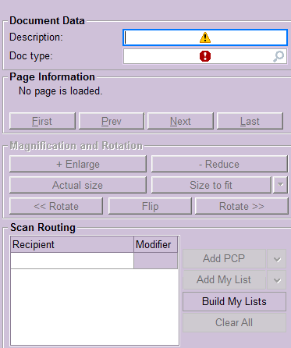
Patient-Level Scanning cont.
Enter a description (if applicable) in the description field.
Type or click magnifying glass to select the Document Type.

Slide 26
Patient-Level Scanning cont.
Insert the document into the scanner click on ‘Acquire’
Once the document is scanned, take one last look at the document to ensure accuracy and click ‘Save doc’.
‘X’ out of the ‘Patient Scan’ screen
The document will flow into ‘Media Manager’ and be viewable across patient’s encounters.

Slide 27
Let's Scan!!
For training today we will click “Import” and select the electronic document from the computer folder.
Have your scanning grid ready – use Ctrl-F to search for the correct Document Type.
Access the patient level scan examples.

Slide 28
Find your scanned document
Open Chart Review
Look in Encounters tab
Look in Media tab

Slide 29
Encounter-Level Scanning
Encounter level documents are clinical documentation that is not diagnostic test results. Examples: Consults, Progress notes, Consents, FMLA forms
Encounter level documents reside within a specific encounter, for example:
Office visit
External record encounter
Telephone encounter
NO diagnostic result type documentation is scanned to this level.
Note: Two patient identifiers should be located on every page of the document that you are scanning

Slide 30
What Encounter Do I Scan to?
Internal (Office Visit, Appointment, etc):
Documentation that has been created inside of your practice that does not interface (automatically file) with Epic.
For internal documents, an encounter should exist in Epic to scan to because the document was completed during the patient’s visit.
External (External Record Encounter):
Documentation that has been created outside of your practice and does not reside in Care Everywhere.
When there is no patient care encounter to attach the documents to, an External Record Encounter should be created.
(Order-level test results from an outside facility will be scanned to the order and connected to an external record encounter

Slide 31
Encounter Level Cont.
Create an External Record Encounter to scan all external documents
For Incoming History or Run-On records, use the most current date of service as Contact Date.
‘Contact Date’ = the date of service on the document
Exception: Order Level Scanning the contact date will be 01/01/current year. I.E., 01/01/2021
(Order level scanning to come)
You must be logged into Epic with your HIM department (SITE MED INFO) to be able to create an external record encounter.
Note: Department will be assigned at Go-Live

Slide 32
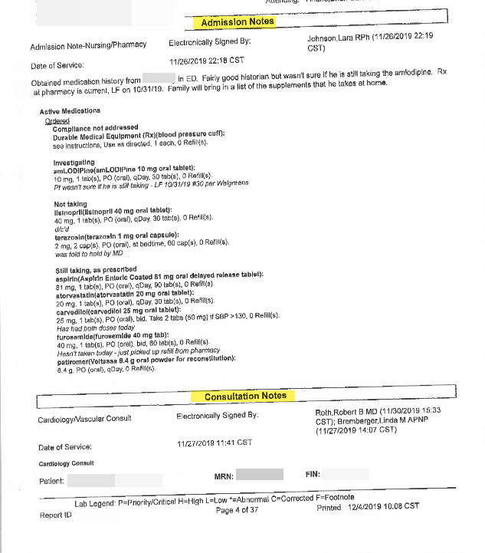
Encounter Level Cont.
Run On Documents scan as Document Type ‘Incoming History’:
A document that cannot be separated. For example: Progress note that ends halfway down the page and an imagining report starts immediately after it on the same page.
Add description of Facility and Date Range. I.e., CSM 6/17/18-6/20/18)

Slide 33
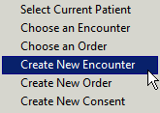
Encounter Level Creation
Creating an Encounter Via Media Manager:
Click on the down arrow next to “Patient” in the ‘New files will be attached to’
Click on “Create New Encounter”
Fill in the New Contact fields as identified below:
Contact date: Date of Service located on the document (today’s date automatically populates)
Contact type: External Record
Provider: Provider, Outside [9998]
Department: Select the appropriate department (Site will be assigned at go-live)
3. Select ‘Create Encounter’

Slide 34
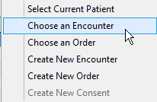
Encounter Level Scanning
Documents are scanned to
Existing Encounter (Practice office visit)
“External Record” Encounter created by the Scanning Team Member
Scanning to an existing encounter:
Navigate to media manager
Click down arrow next to patient
Click on ‘Choose an Encounter”
Choose the encounter that corresponds to date of service or date document was signed.
The encounter you chose will show in blue at the top
Click on ‘Scan’

Slide 35
Encounter Level Continued…
Enter a description (if applicable)
Select Document Type
To route to physician, enter name under ‘Recipient’ (Your practice can decide when documents should be routed)

Slide 36
Encounter Level Continued…
Insert the document into the scanner click on ‘Acquire’
Once the document is scanned, take one last look at the document to ensure accuracy and click ‘Save doc’.
‘X’ out of the ‘Patient Scan’ screen
The document will flow into ‘Media Manager’ and attach to the selected encounter.

Slide 37
Let's Scan!!
Access the Encounter-Level Scanning Examples in the folder to begin hands-on practice
Have your grid ready!

Slide 38
Find your scanned document
Open Chart Review
Look in Encounters tab
Look in Media tab

Slide 39
Time for a well-deserved break!

Slide 40
Order-Level Scanning
Diagnostic test results should be scanned to the Order-Level
Examples: US, XR, Mammo, EKG, ECHO, PFT, etc.
Order-level documents file into the appropriate tab in Chart Review
(The order may have been created by patient care or by the scanning team member)
Examples: EKG will file to the ‘CARDIAC DX’ tab. X-ray & Mammo will file to the ‘Imaging’ tab.

Slide 41
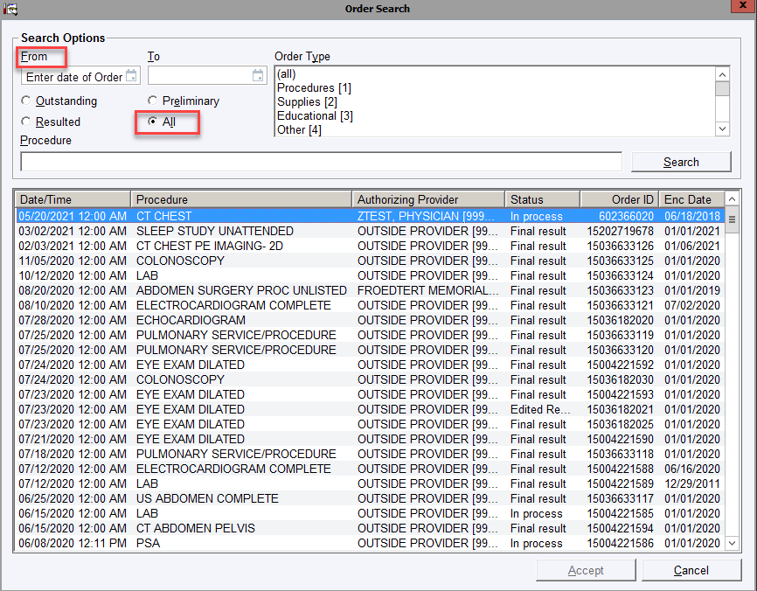
Order Level Scanning Cont.
Scanning Order Level Document:
Open patient’s chart via ‘chart’ or ‘Media Manager’
Click the down arrow next to New files will be attached to: ‘Patient’
Click ‘Choose an Order’
The ‘Order Search’ box will appear
Enter the date of the order in the ‘From’ box or delete date in ‘from’ box and click on ‘All’ radio button to populate all orders for the patient.
Click on the order
In Media Manger, Click on ‘Scan’

Slide 42
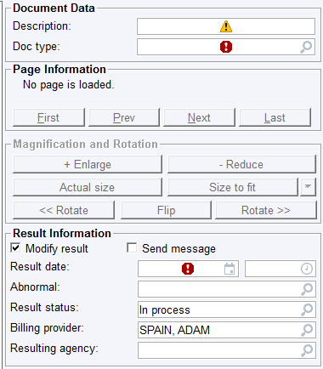
Order Level Cont.
Enter a description (if applicable)
Enter Document Type
If there is no ‘Result Date’ in the ‘Result Information’ section, click the ‘modify result’ check box. Enter the result date.
Important! The ‘Result Status’ should be left ‘In Progress’. Do NOT finalize orders that the clinician is responsible to finalize.
To Route to clinician, click on ‘CC’ and enter clinician's name in ‘CC Recipients of Results’ box.

Slide 43
Order Level Continued…
Insert the document into the scanner click on ‘Acquire’
Once the document is scanned, take one last look at the document to ensure accuracy and click ‘Save doc’.
‘X’ out of the ‘Patient Scan’ screen
The document will flow into ‘Media Manager’ and attach to the selected order, and will also be visible within the encounter the order was created within.

Slide 44
Now let’s try order-level scanning when there is not an existing order placed in Epic

Slide 45
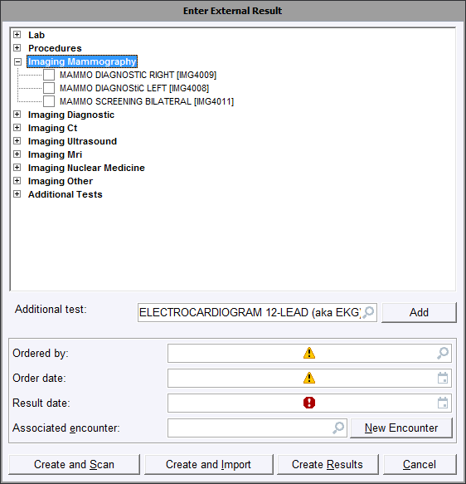
Creating an Order in EPIC
Open patient’s chart via ‘Media Manager’
Click the down arrow next to ‘Patient’, Select ‘Create New Order’
The ‘Enter External Results’ box appears
Search through the result tree for the order. If you cannot find the order, start typing in the ‘Additional Test’ field and press enter.
Choose the closest order to match the document to be scanned.
In the ‘Enter External Result’ box, enter:
Ordered by: Enter ordering provider or leave blank for Outside Provider (it will default in later)
Order date: Enter the date the test was ordered (if unknown use the result date)
Result date: Enter the date the test was resulted
NOTE: The Result Date should never be prior to the Order Date.
Associated encounter: Click the magnifying glass to select the encounter.
NOTE: All Orders must live inside of an encounter! Even when scanning ‘order-level’, you must attach an order to an encounter when creating an order.

Slide 46
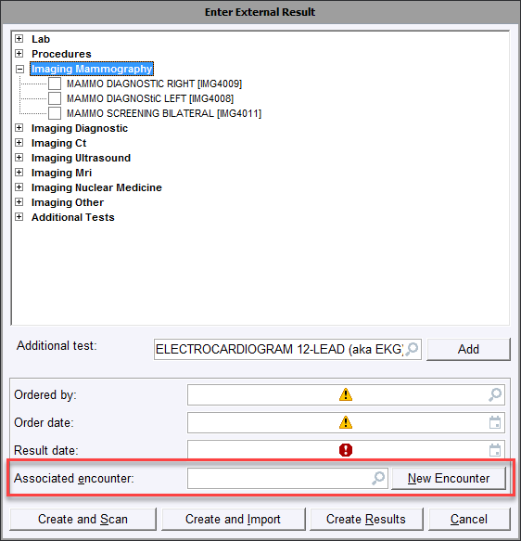
Creating an Order in EPIC Continued…
If you need to create an encounter, click on the “New Encounter” button. Enter the Encounter information in the “New Contact” box
Use 1/1/current year as the encounter date. This is different than encounter-level scanning where date of service is used.
Once you select or create your encounter, it will appear in the “Associated Encounter” field.
Click Create and Scan
Note: Since you entered the “Result Date” above, the order will automatically be finalized in the scan screen.

Slide 47
Order Level Continued…
Enter a description (if applicable) in the description field.
Type or click magnifying glass for Document Type.
If there is no ‘Result Date’ in the ‘Result Information’ section, click the ‘modify result’ check box. Enter the result date.
Important! The ‘Result Status’ should be left ‘In Progress’. Do NOT finalize orders the clinician is responsible to finalize.
To Route to clinician, click on ‘CC’ and enter clinician's name in ‘CC Recipients of Results’ box.

Slide 48
Eye Exams
Dilated or non-dilated eye exams that contain results.
HIM will enter the components from the report for health maintenance. This allows for tracking and trending for patient care.
The three orders for eye exam reports are:
Eye Exam Dilated (SCAN19) - Use for all exams that mention either dilated or diabetic
Eye Exam Non-Dilated (SCAN20) - Use for exams with no mention of dilated or diabetic
PRO9000152 Diabetic Retinavue Eye Exam – Use for Retinavue reports/images

Slide 49
Creating an Order for Eye Exams
Open the patient chart via ‘encounter’
Find the external record for 01/01/current year or create a new external record encounter.
‘Enter/Edit Results’ will appear. Click on ‘Ext Results’

Slide 50
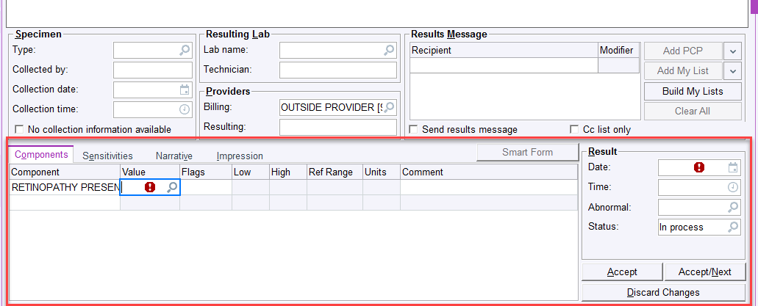
Creating an Order for Eye Exams
In ‘Additional test’ type in the appropriate order for the eye exam report
Enter the ‘order date’ which is the date the exam was done. ‘Create Results’
‘Enter/Edit Results’ will reappear. Enter the correct information under ‘value’
In ‘Category Select’ choose value
The ‘Result’ date will be the date of exam
Click ‘Accept’ and ‘x’ out. Do NOT sign the visit.

Slide 51
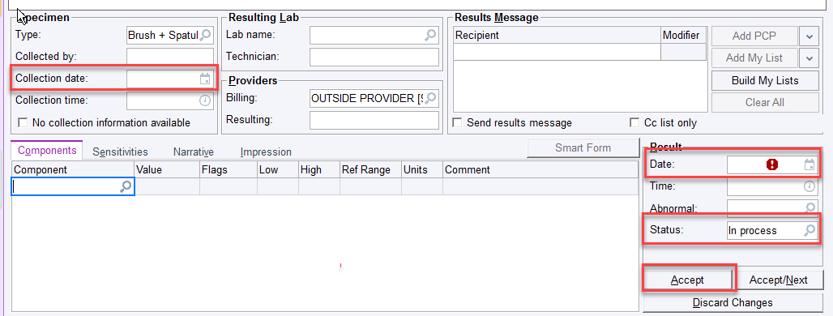
Pap Smear/Pap Test
To create a pap order:
Open the patient chart via Encounter
Find the 01/01/current year encounter with site department
In ‘Enter/Edit Results’, click on ‘Ext Results’
Enter ‘Pap Order [LAB10332]’ in the additional test. Add ‘order date’ and click create results.
‘Enter/Edit Results’ will reappear. Enter the collection date, the result date, and change status to finalize. Click ‘Accept’.
Go to Media Manager-> ‘Choose order’ at Patient Drop Down-> Find PAP order.

Slide 52
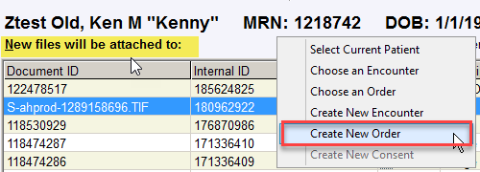
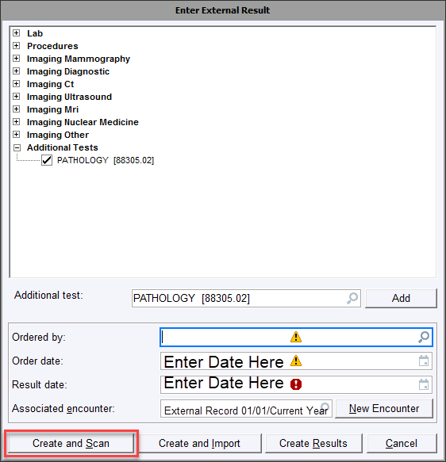
Pathology
To Create a pathology order:
Go to chart -> Media Manager -> Select ‘Create New order’ from New Files will be attached to.
Use generic pathology code (88305.02) in the additional test field
Enter the order date and result date and attached to the external record encounter 01/01/current year for the site.
Click ‘Create and Scan’

Slide 53
Let's Scan!!
Access the Order-Level Scanning Examples in the folder to begin hands-on practice
Have your grid ready!

Slide 54
Find your scanned document
Open Chart Review
Look under the appropriate tab
Lab, Imaging, Cardiac DX, etc.
Look in Encounters tab
Look in Media tab

Slide 55
Additional Info
Multiple results for the same test can be grouped together for easier scanning:
Use 1 order if the documents are the same
Example: 5 bilateral mammogram results are received in a large volume of incoming records. Place 1 Mammogram order, final result it with most recent result date, scan all mammogram results as a single scan to the order with the most current date on top, and enter the Facility Name and Date Range in the Document field.

Slide 56
Onto Advance Directive Processing Please open the AD Scanning Procedure Please note: This process will be changing due to an Epic upgrade in September 2021

Slide 57
Advance Directives
Advance Directives (AD) are essential to patient care.
They must be scanned accurately and timely into EPIC (patient-level) so that they are available in the event they must be acted upon.
Advance directive template documentation must also be completed in order for the appropriate Storyboard banners and alerts to display.
Advance Directive examples:
Guardianship
Power of Attorney for Healthcare (POA-HC)
Physician Orders for Life-Sustaining Treatment (POLST)
Living Will
Declaration for Mental Health Treatment
Certification of Incapacity (WI Activation)

Slide 58
Advance Directive Scanning
Open the patient chart via ‘Media Manager’
Search to see if the document has been scanned previously by clicking on the document type column header to sort. Review documents beginning with ‘Directives-’.
If document has not been scanned, review document for completeness and validity according to the AD procedure
Note – if the AD is not complete, please reach out to the patient to obtain a valid copy. Letters can be created from within Epic if desired.

Slide 59
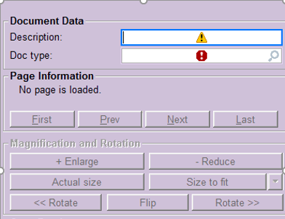
Advance Directive Scanning Cont.
Ensure that “Files attached to” is at the patient-level, then click Scan.
Enter a description (if applicable, according to the AD procedure)
Enter the Document Type (“Directives-……”)

Slide 60
Advance Directive Scanning Cont.
Insert the document into the scanner click on ‘Acquire’
Once the document is scanned, take one last look at the document to ensure accuracy and click ‘Save doc’.
‘X’ out of the ‘Patient Scan’ screen
The document will now be available across the patient’s record.

Slide 61
Let's Scan!!
Access the Advance Directives Scanning Examples in the folder to begin hands-on practice
Have your AD Procedure ready!

Slide 62
Find your scanned AD document
Open Chart Review
Look in Media tab

Slide 63
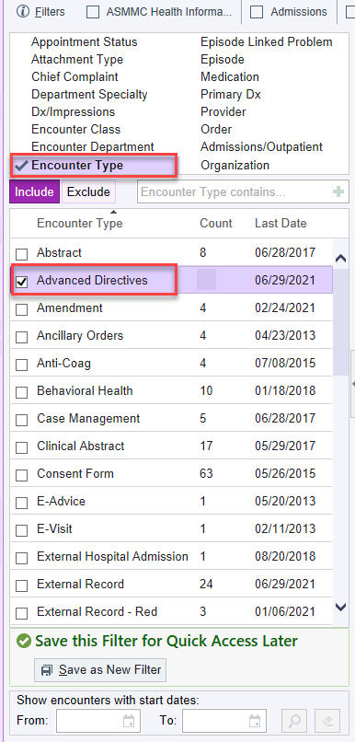
Use filter in encounter tab to confirm if an advance directive encounter already exists.
If an encounter already exists, open through addendum.
You do NOT need to create a new encounter.
If an encounter does not exist, create one.

Slide 64
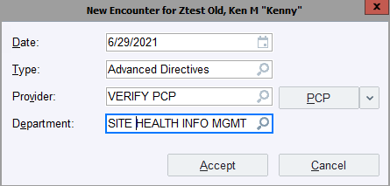
Creating an Advance Directives Encounter
To create an encounter via the “Encounter function”
Click on the Epic button
Open the Patient Care menu and click on “Encounter”
Find/click on the patient's name
The “Encounter Selection” box will open
Click on ‘New”
The “New Encounter” box will open.
Enter the Encounter information into the fields
The ‘Visit Navigator’ will open.
This is where you will document the advance directive.

Slide 65
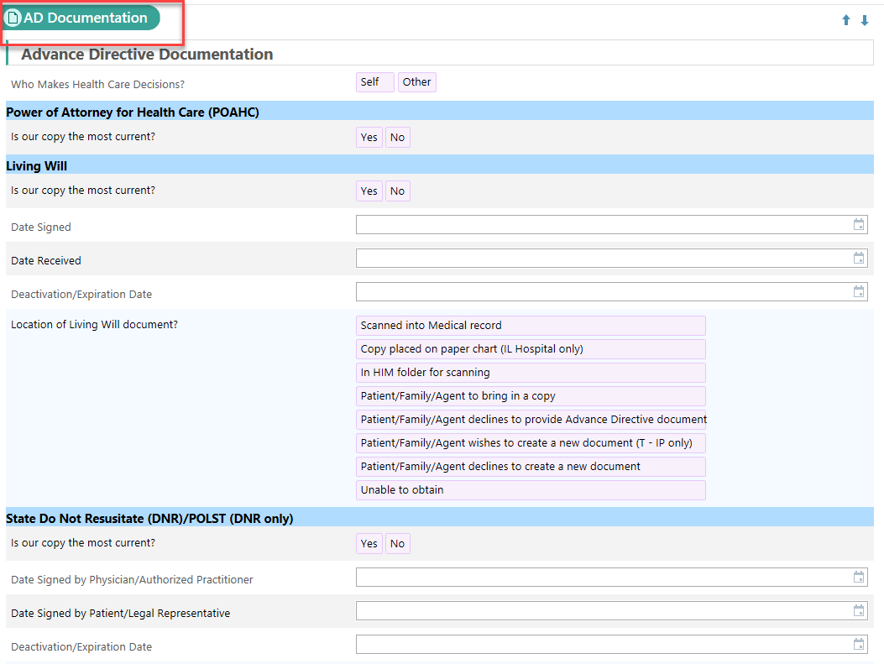
Advance Directive Documentation Template
In the Advance Directive encounter, go to the ‘AD Documentation’. Information must be accurately entered to allow for safe patient care and to enable the storyboard alerts to display.
Once the information from the directive is added to the template, click ‘sign visit’

Slide 66
Let’s complete the AD template!
After completing the documentation template, check if the storyboard banner alerts display properly

Slide 67
CHART CORRECTIONS
Editing a scan
Deleting a scan
Marking an encounter as erroneous
Order entry errors

Slide 68
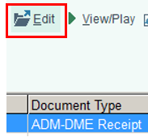
Scan Error Corrections
To edit a document
Open the patient chart via Media Manager
To edit a document, click on the document then click Edit
From this screen, the document type or description can be edited. The document can also be moved to a different encounter or order.
*FYI: Certain document types cannot be edited, and will need to be printed, deleted, and re-scanned. Examples: H&P, Consult, Progress notes.

Slide 69
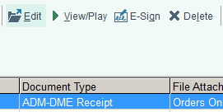
Scan Error Corrections
To Delete a document:
Open the patient chart via Media Manager
Click Delete
Enter a deletion reason, then click Delete
Note:
If a wrong patient scan error was discovered: after deletion of the erroneous document, refer the situation for a privacy investigation.

Slide 70
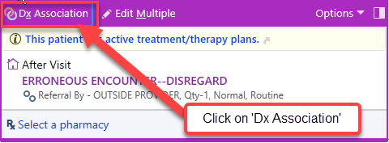
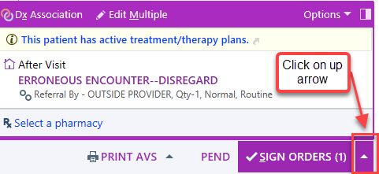
Scan Error Corrections
Erroneous Encounter Process
Select the patient and open the encounter via 'Encounter'
Click 'Add Order'
Search erroneous, press enter, and accept
Click on 'DX Association' and type Erroneous in the diagnosis field. Select 'Erroneous Encounter-Disregard'
Click Accept
Click 'DX Associate' and enter erroneous in the diagnosis field
Click on add and then accept
Click on the ‘up’ arrow next to ‘sign orders’ and select remove all
At the ‘Orders Cart’ box, select ‘Do not show this again’ and ‘remove’
Sign the encounter using ‘Sign Visit’
Note- Place a ticket with Epic IT - orders created in error must be deleted by IT

Slide 71
CONGRATULATIONS!
Thank you for your time and participation today.
For questions and ongoing support, please reach out to the HIM Quality & Training Specialists:
HIMQACoordTeam@aah.org

Slide 72
Phone Number for IT in IL: 630-990-7000

